Slide 1
Entering Pregnant Sailors in Medical Readiness Reporting System (MRRS)
This information should be entered in MRRS by medical personnel with appropriate supporting documentation.

Slide 3
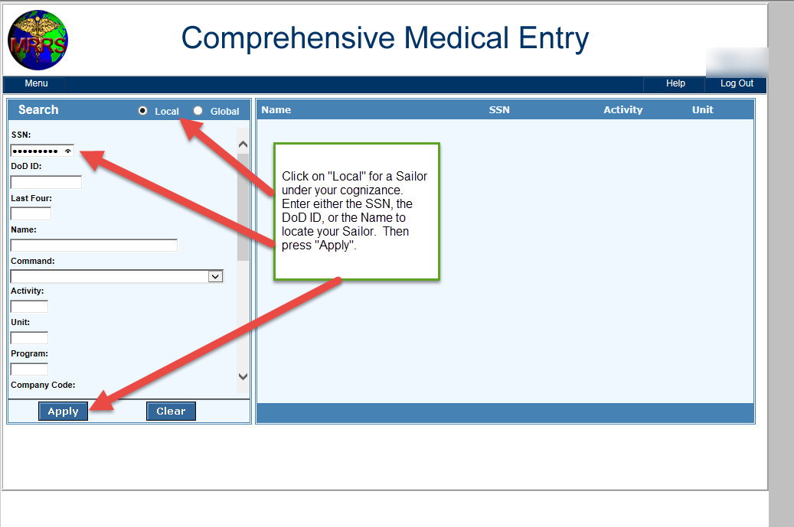

Slide 4
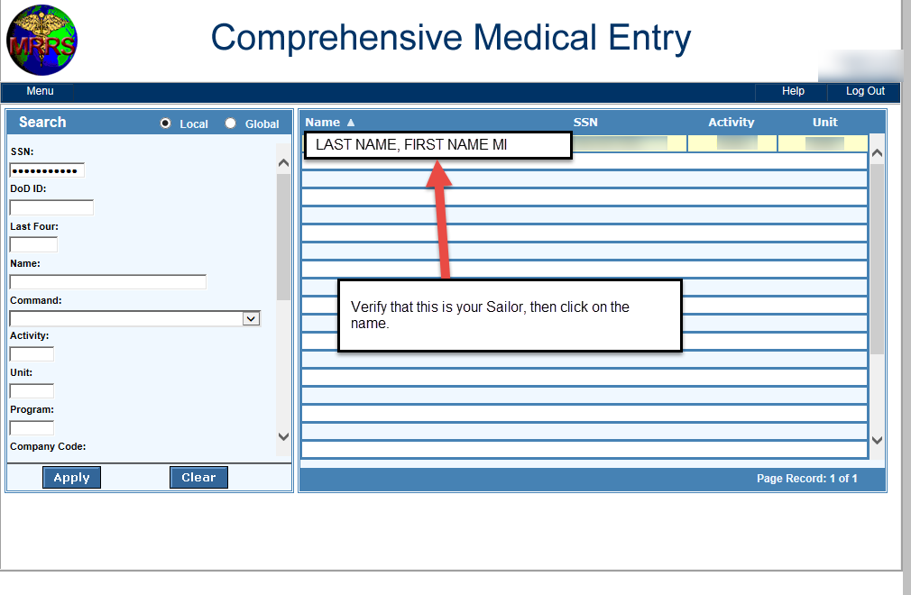

Slide 5
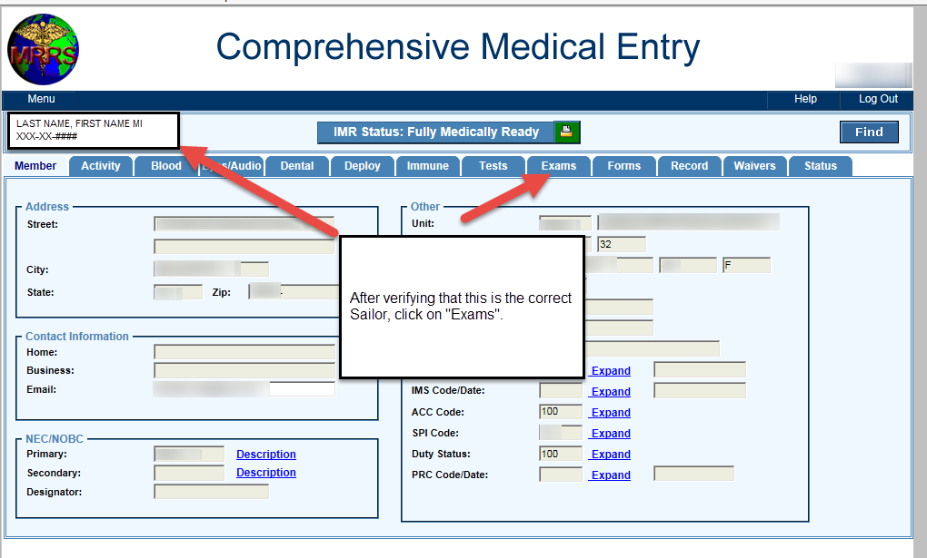

Slide 6
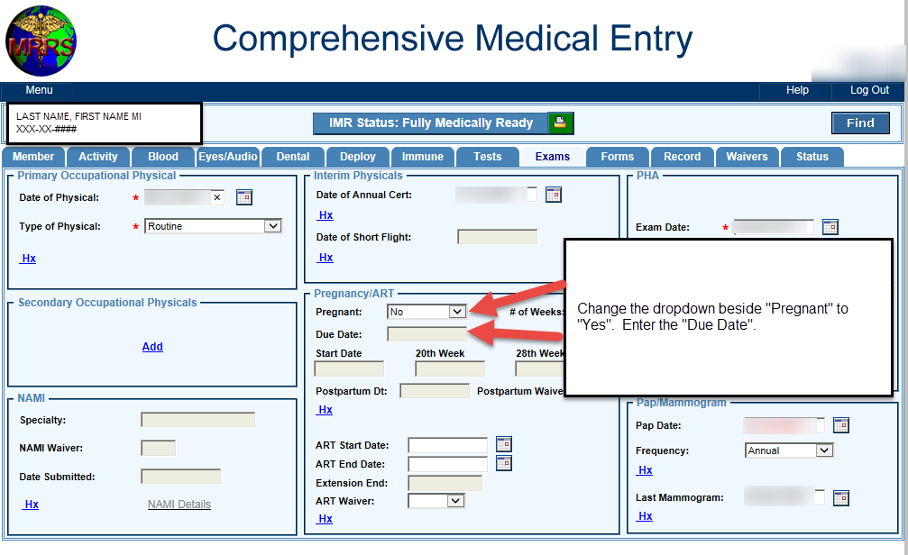

Slide 7
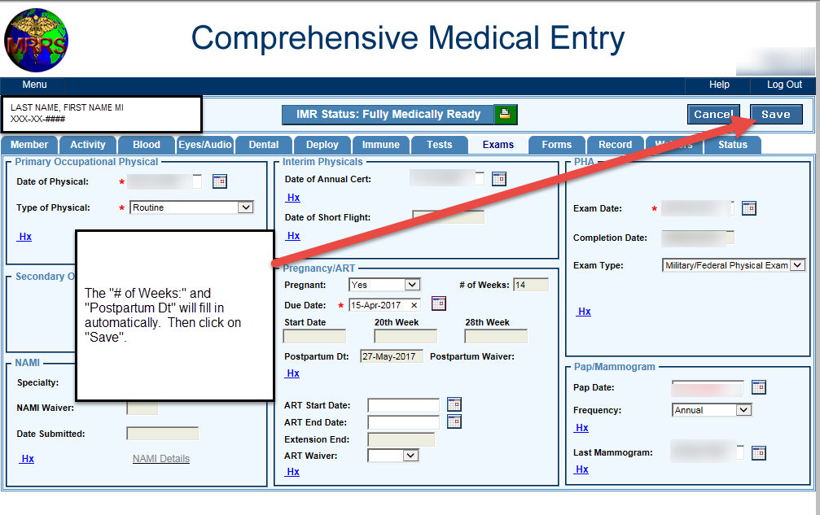

Slide 8
